Slide 1
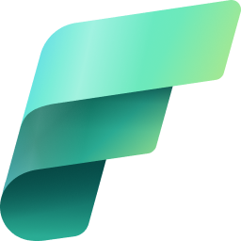
Microsoft Fabric: Data PLATFORM OF The era of AI
Francis Folaranmi

Slide 2

Francis Folaranmi
Francis is a Microsoft-certified data professional who is focused on Microsoft’s all-in-one analytics solution for enterprises – Microsoft Fabric. He has a strong background in Power BI and Azure development but has been at the forefront of Fabric Analytics engineering since its inception.
His experiences span maritime industry, banking and non-banking financial institutions.

Slide 3
CONTENT
Introduction
What is Microsoft Fabric?
History of Microsoft Fabric
What makes Microsoft Fabric standout?
Microsoft Fabric Workloads
OneLake

Slide 4
CONTENT…
Data Ingestion
Using Dataflow Gen 2 to Ingest On Prem Data
Exporting Power Query Template
Ingesting Data with Notebook
Using Data factory to copy data from Blob Storage
Project 1 – Ingesting Data from API source

Slide 5
CONTENT…
Medallion Architecture
Using Notebook
Using Dataflow Gen 2
Data Warehousing
Lakehouse vs Warehouse
Uniting Lakehouse and Data warehouse
Cross warehouse querying

Slide 6
CONTENT…
Data Science
Sample ML Model
Data Preparation with Data wrangler
Data Activator
Real time Analytics
Licensing and Adoption
Project 2 – End to End Project

Slide 7
Pre-requisites…
Microsoft 365 Developer account
Microsoft Fabric Free trial

Slide 8


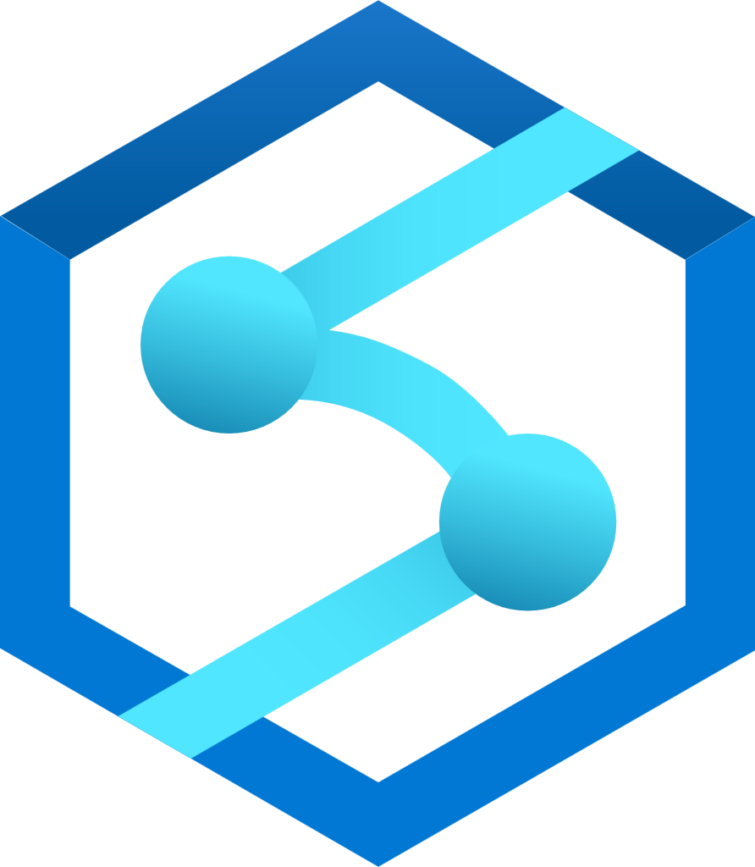


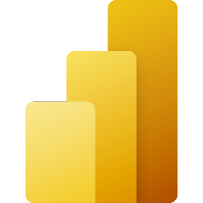
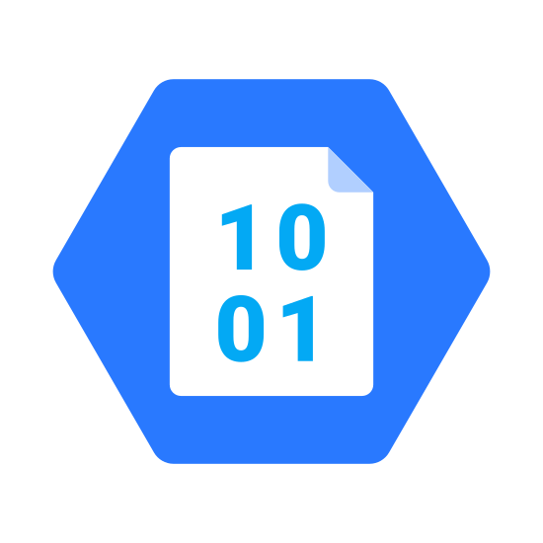

What is Microsoft Fabric?
Unified
Analytics Platform
Data
Integration
Data
Engineering
Data Warehousing
Real-
Time Analytics
Data Science
Business Intelligence
Data Lake
Governance and Administration

Slide 9
History Of Microsoft Fabric?
Announced in June 2023
Microsoft Fabric
Synapse Analytics
Azure Data Factory
Power BI

Slide 10
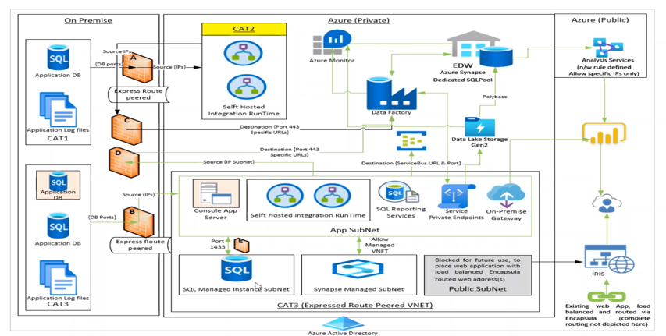
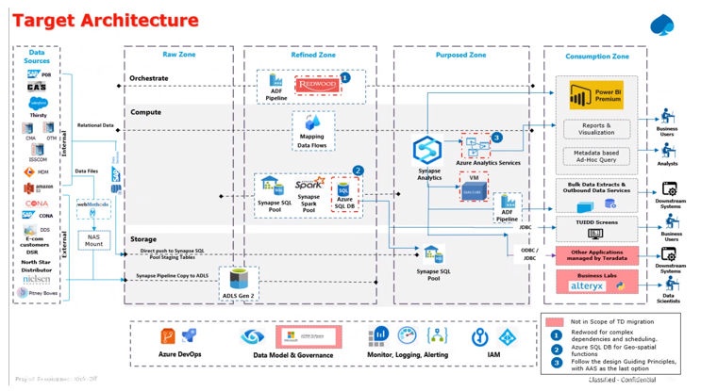
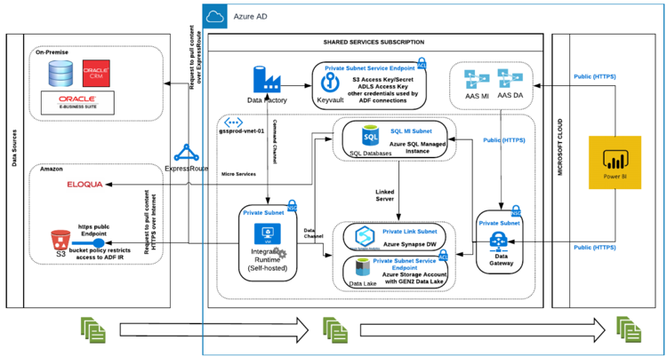
Why Microsoft Fabric ?
Scalable analytics are complex and fragmented
Every analytics project has many subsystems
Every subsystem need a different class of product
Products often come from multiple vendors
Integration at scale across products is complex, fragile, and expensive

Slide 11
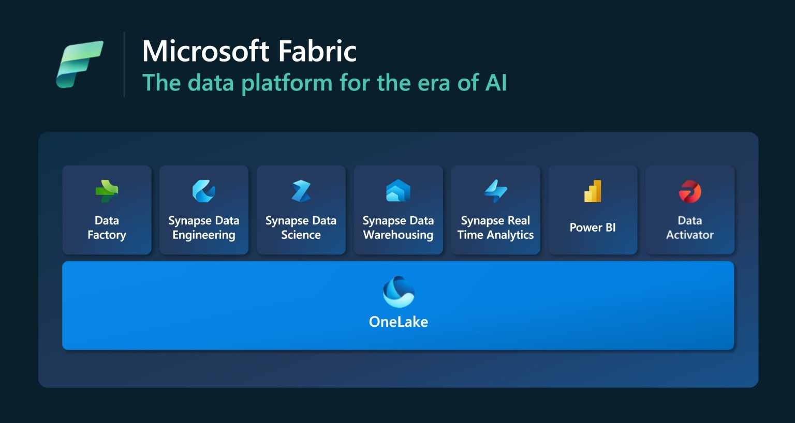
11
Microsoft Fabric Workloads

Slide 12

OneLake for all Data
“The OneDrive for Data”
Data
Warehousing
Data
Engineering
Data Integration
Data
Science
Real
Time
Analytics
Business Intelligence
A single SaaS lake for the whole organization
Provisioned automatically with the tenant
All workloads automatically store their data in the OneLake workspace folders
All the data is organized in an intuitive hierarchical namespace
The data in OneLake is automatically indexed for discovery, MIP labels, lineage, PII scans, sharing, governance and compliance
OneLake Storage
Intelligent data fabric

Slide 13
One Copy for all computes
Universal security makes it real
Data
Warehousing
Data
Engineering
Data Integration
Data
Science
Real
Time
Analytics
Business Intelligence
All the compute engines store their data automatically in OneLake
The data is stored in a single common format
Delta – Parquet, an open standards format, is the storage format for all tabular data in Fabric
Once data is stored in the lake, it is directly accessible by all the engines without needing any import/export
All the compute engines have been fully optimized to work with Delta Parquet as their native format
Shared universal security model is enforced across all the engines
Serverless
Compute
T-SQL
Spark
KQL
Analysis Services
OneLake Storage
OneSecurity
Finance
Customers 360
Service Telemetry
Business KPIs
Delta – Parquet Format
Delta – Parquet Format
Delta – Parquet Format
Delta – Parquet Format

Slide 14
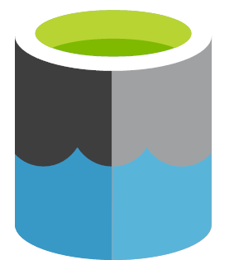
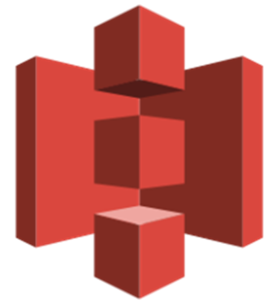
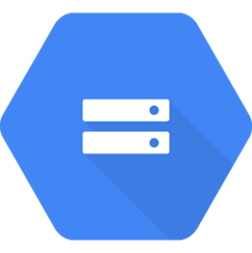
Taking One Copy to the next level
Shortcuts
Sharing data in OneLake is as easy as sharing files in OneDrive, removing the needs for data duplication
With shortcuts, data throughout OneLake can be composed together without any data movement
Shortcuts also allow instant linking of data already existing in Azure and in other clouds, without any data duplication and movement, making OneLake the first multi-cloud data lake
With support for industry standard APIs, OneLake data can be directly accessed by any application or service
Data
Integration
Data
Engineering
Data Warehousing
Real
Time Analytics
Data Science
Business Intelligence
OneLake Storage
Finance
Customers 360
Service Telemetry
Business KPIs
Azure
Amazon
Google

Slide 15




Data Ingestion and transformation
The choice of tools for your data transformations
Spark Job
Definitions
Data Flows
Notebooks
Data pipelines
Code-based pipelines
UI-based pipelines
Notes:
The Synapse data engineering experience in Microsoft Fabric enables you to implement data transformations the ways you want, with the tools you prefer. For a code-based ETL, you can use Spark Notebooks written in Python, Java or R, or simply execute Spark jobs with your own code. And for the most common scenarios, you can create low-code ui-based pipelines with Data pipelines and Data flows Gen 2.

Slide 16
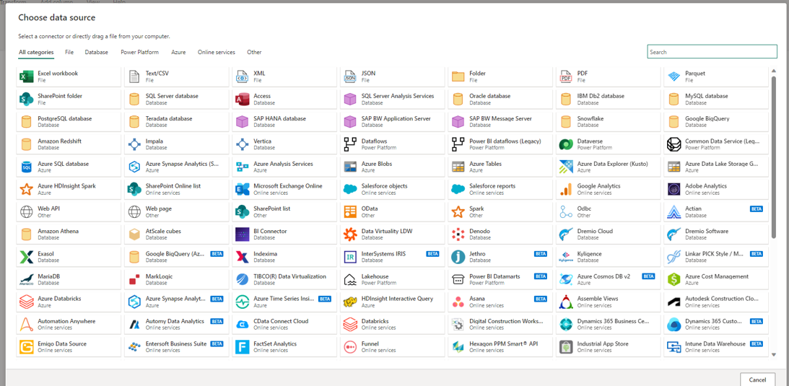
Ingest data from 100+ sources with Connectors with Dataflow Gen 2
Notes:
The Synapse data engineering experience in Microsoft Fabric enables you to implement data transformations the ways you want, with the tools you prefer. For a code-based ETL, you can use Spark Notebooks written in Python, Java or R, or simply execute Spark jobs with your own code. And for the most common scenarios, you can create low-code ui-based pipelines with Data pipelines and Data flows Gen 2.

Slide 17
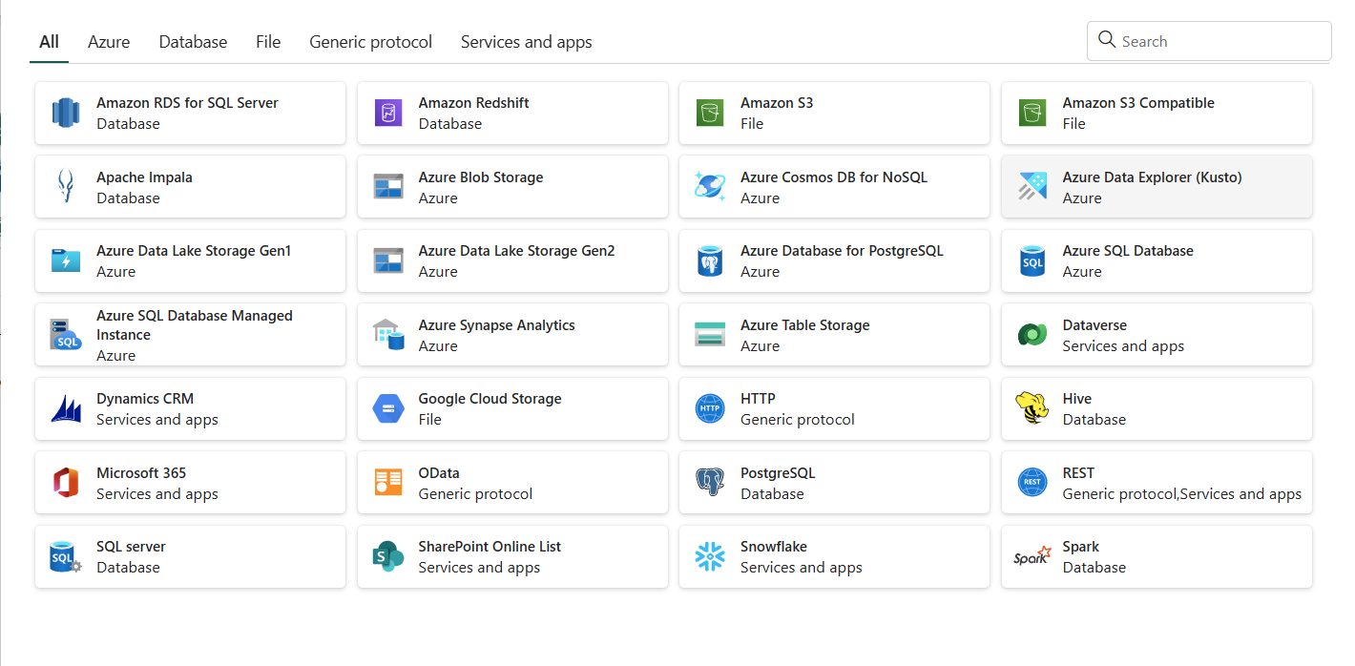
Ingest data with Data Factory
Notes:
The Synapse data engineering experience in Microsoft Fabric enables you to implement data transformations the ways you want, with the tools you prefer. For a code-based ETL, you can use Spark Notebooks written in Python, Java or R, or simply execute Spark jobs with your own code. And for the most common scenarios, you can create low-code ui-based pipelines with Data pipelines and Data flows Gen 2.

Slide 18

Ingest data with Data Factory
Datasets can be from any source
Activity
Dataset
Pipeline
Activity produces dataset
Pipelines are a sequence of activities
Activities, datasets, and dataflows can be controlled within the pipeline
Notes:
The Synapse data engineering experience in Microsoft Fabric enables you to implement data transformations the ways you want, with the tools you prefer. For a code-based ETL, you can use Spark Notebooks written in Python, Java or R, or simply execute Spark jobs with your own code. And for the most common scenarios, you can create low-code ui-based pipelines with Data pipelines and Data flows Gen 2.

Slide 19
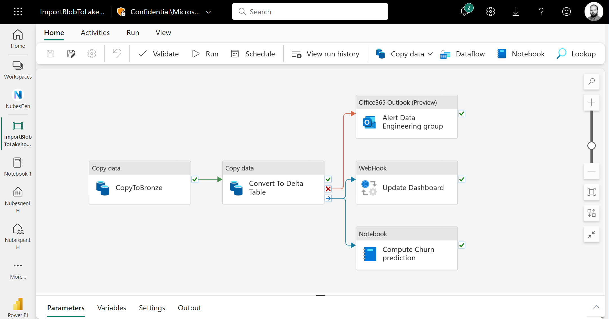
Ingest data with Data Factory
Notes:
The Synapse data engineering experience in Microsoft Fabric enables you to implement data transformations the ways you want, with the tools you prefer. For a code-based ETL, you can use Spark Notebooks written in Python, Java or R, or simply execute Spark jobs with your own code. And for the most common scenarios, you can create low-code ui-based pipelines with Data pipelines and Data flows Gen 2.

Slide 20
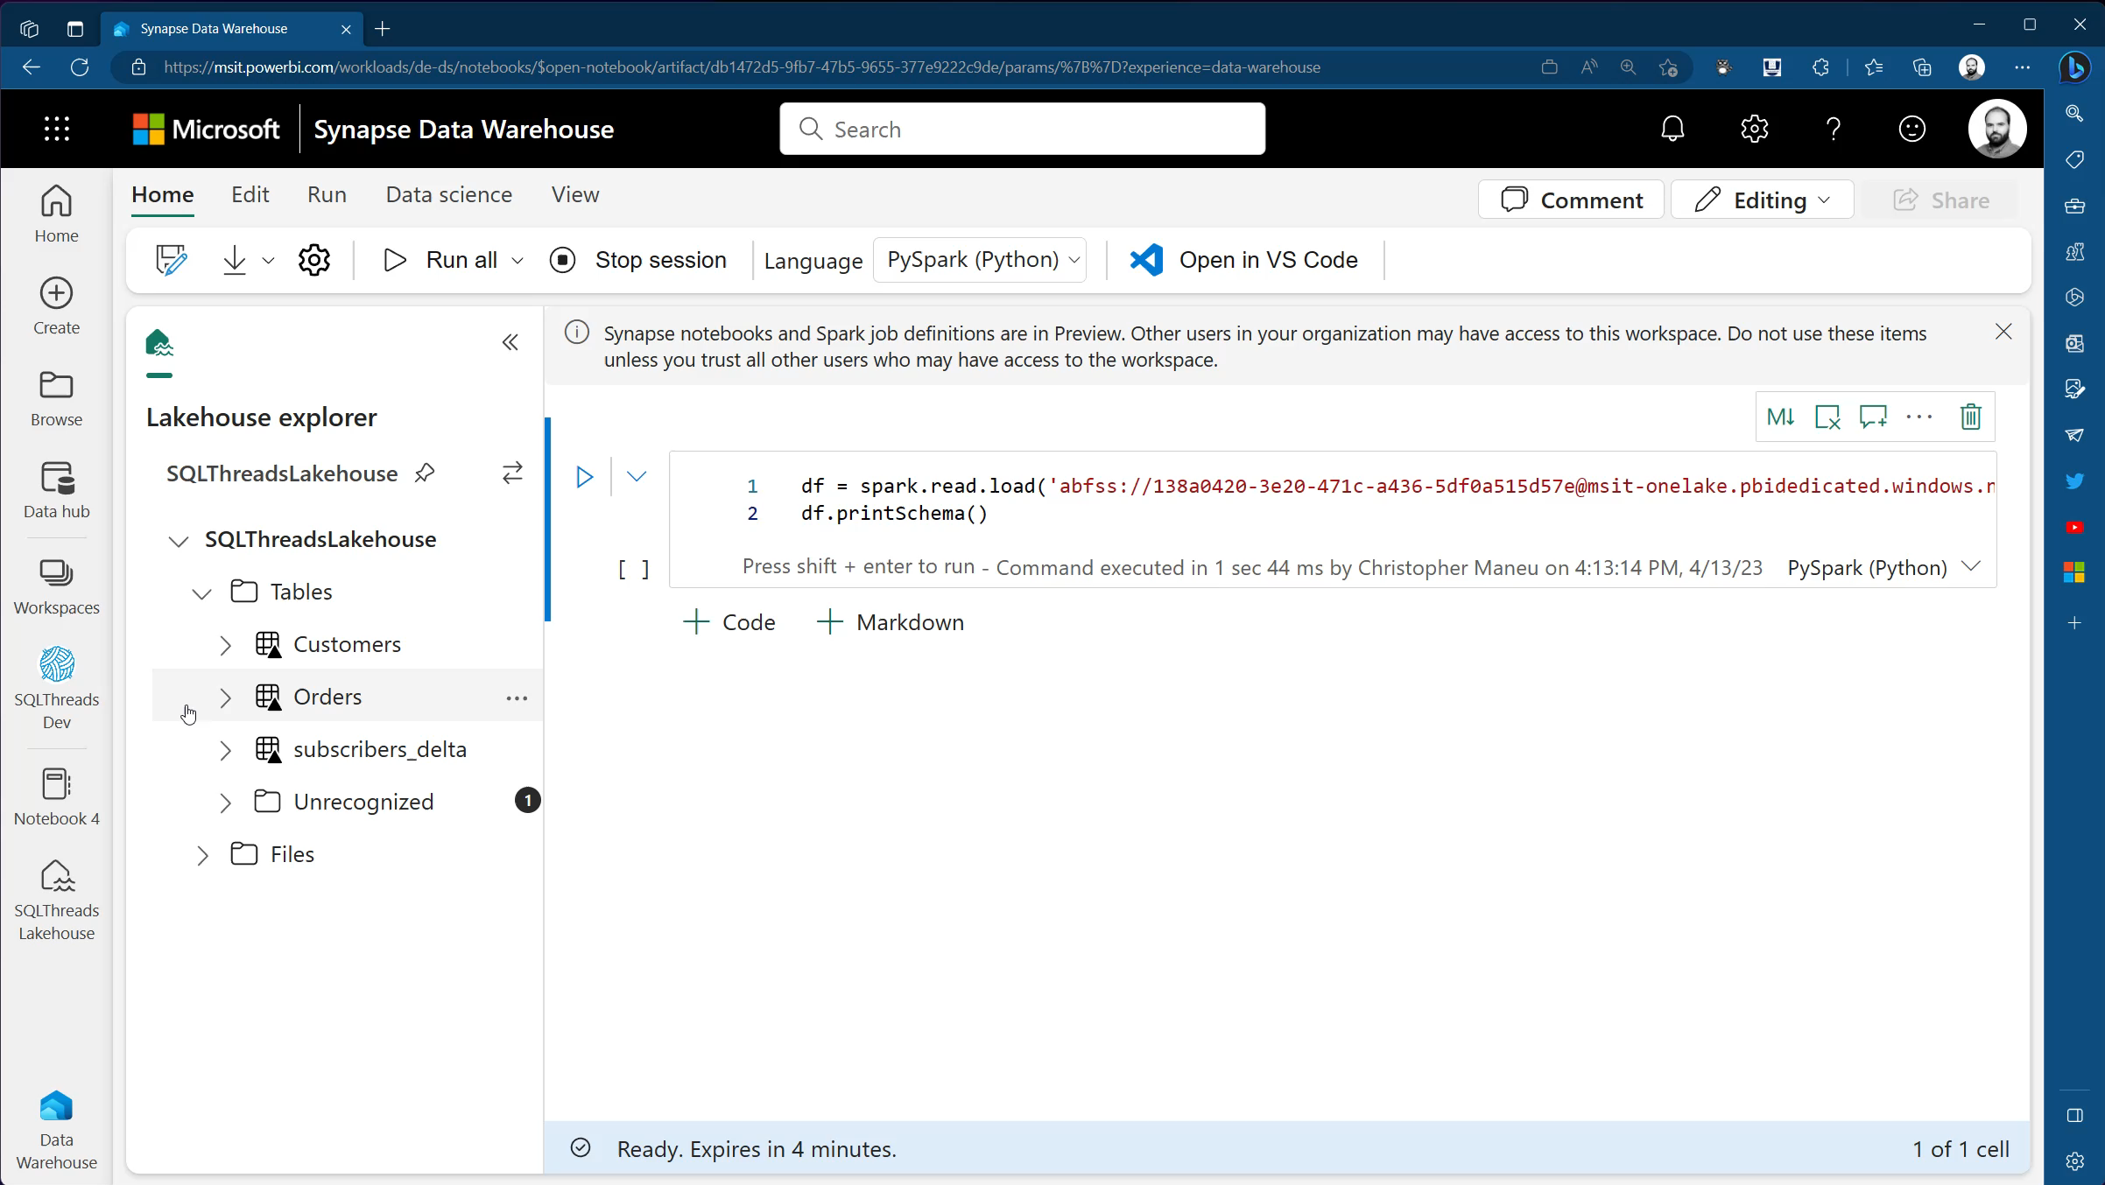
Data Ingestion - Write and run Notebooks from web & VS Code

Slide 21
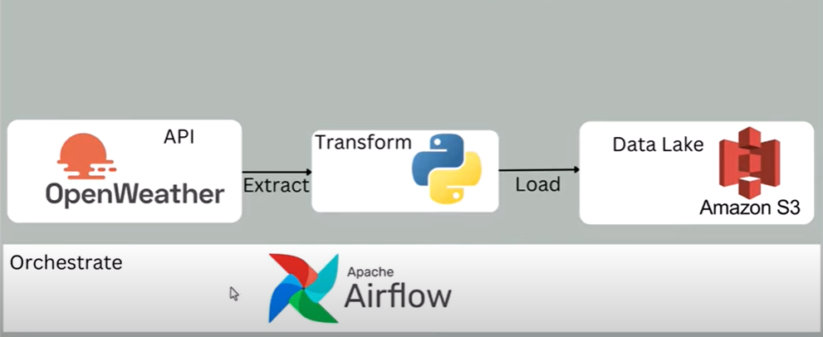
Project 1- Ingesting Data from API source
In this Project, We will replicate this data ingestion using just data factory and Fabric Lakehouse

Slide 22
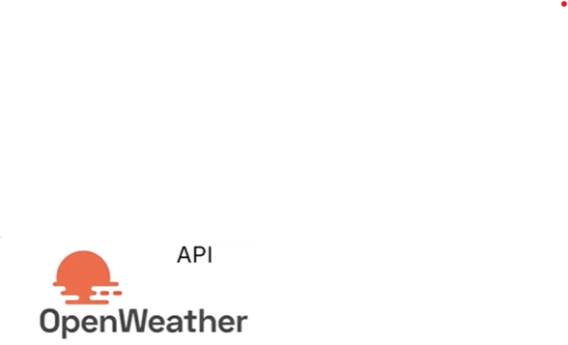
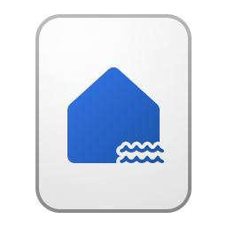
Project 1- Ingesting Data from API source
Lakehouse
Data Factory

Slide 23

DATA WAREHOUSE
It is the 'traditional' data warehouse with full transactional T-SQL capabilities, where you're fully in control of creating tables, loading, transforming and querying your data in the data warehouse using either the Microsoft Fabric portal or T-SQL commands. You can create one or several warehouse within a Fabric workspace. A Synapse Data Warehouse is populated by one of the supported data ingestion methods such as:
COPY INTO
Pipelines
Dataflows
cross database ingestion options such as CREATE TABLE AS SELECT (CTAS)
INSERT..SELECT
SELECT INTO
SQL Endpoint is Automatically created with every Lake House/warehouse
Synapse Data Warehouse
SQL Endpoint

Slide 24
Medallion Architecture
Medallion architecture is a data design pattern used to logically organize data in a lakehouse. It is a multi-layered approach that guarantees atomicity, consistency, isolation, and durability. The architecture is divided into three zones:
Bronze
Silver
Gold

Slide 25
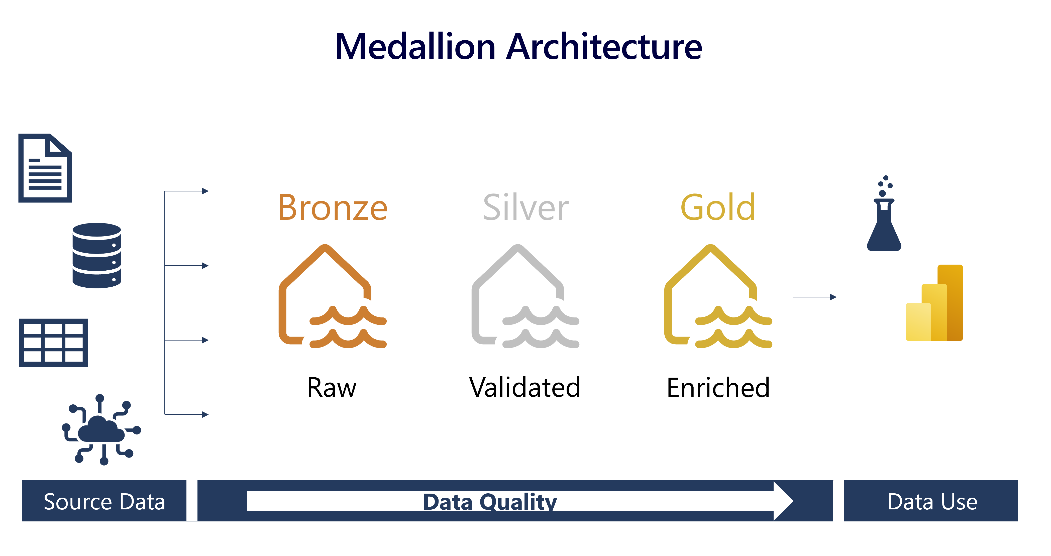
Medallion Architecture

Slide 26
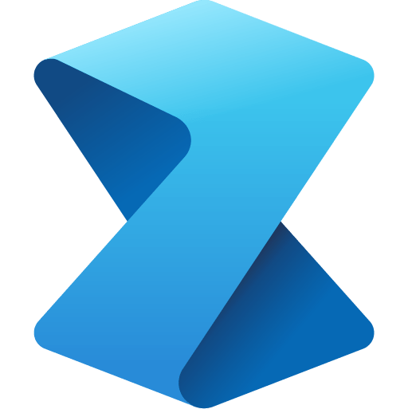
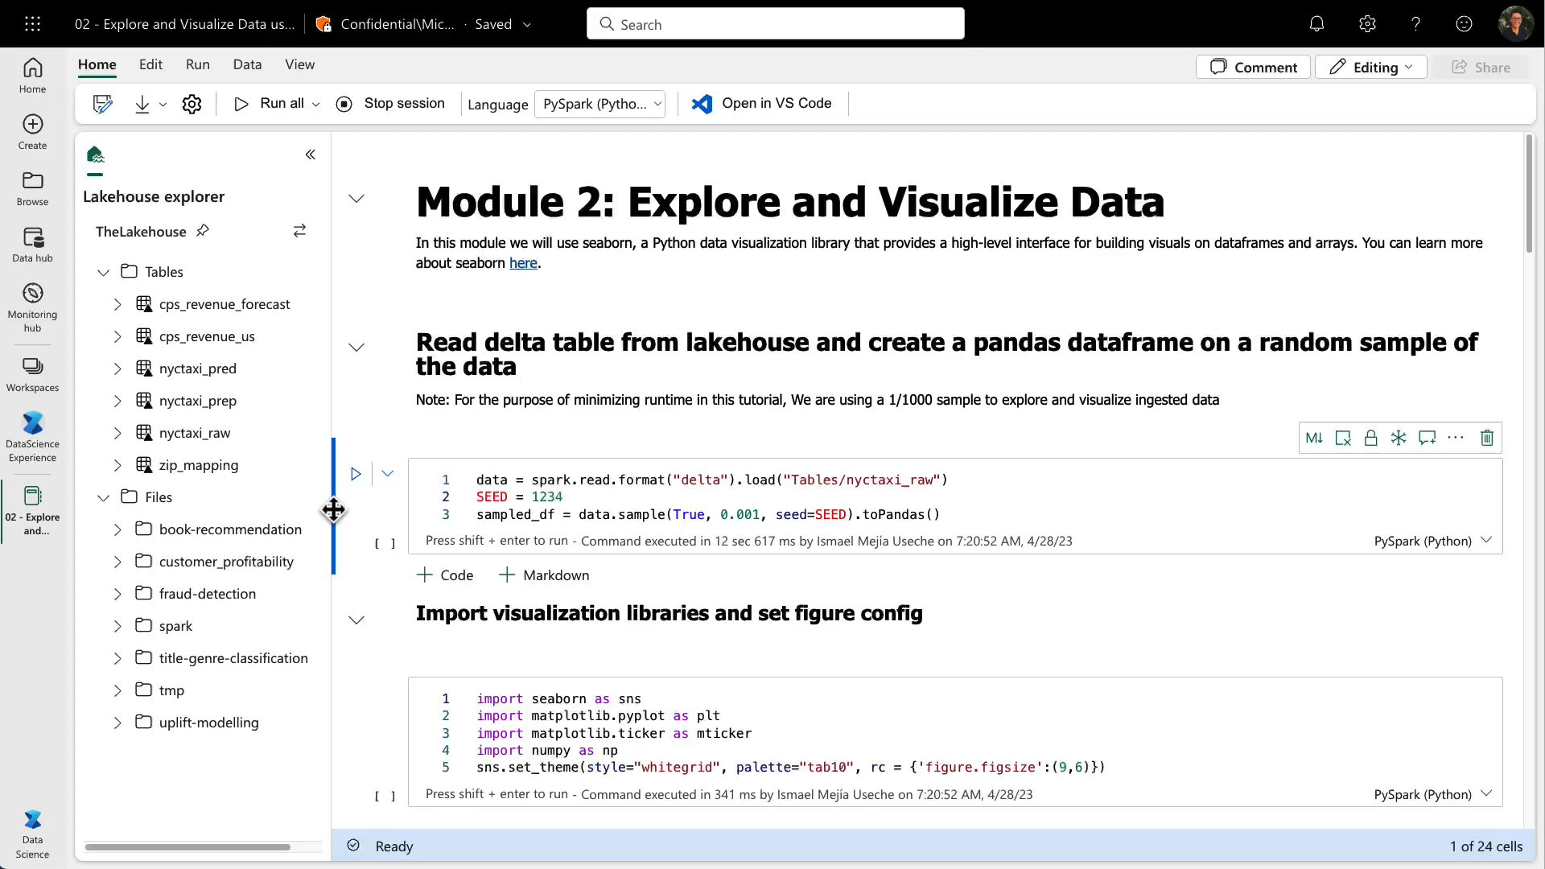
Data Science - Notebooks

Slide 27
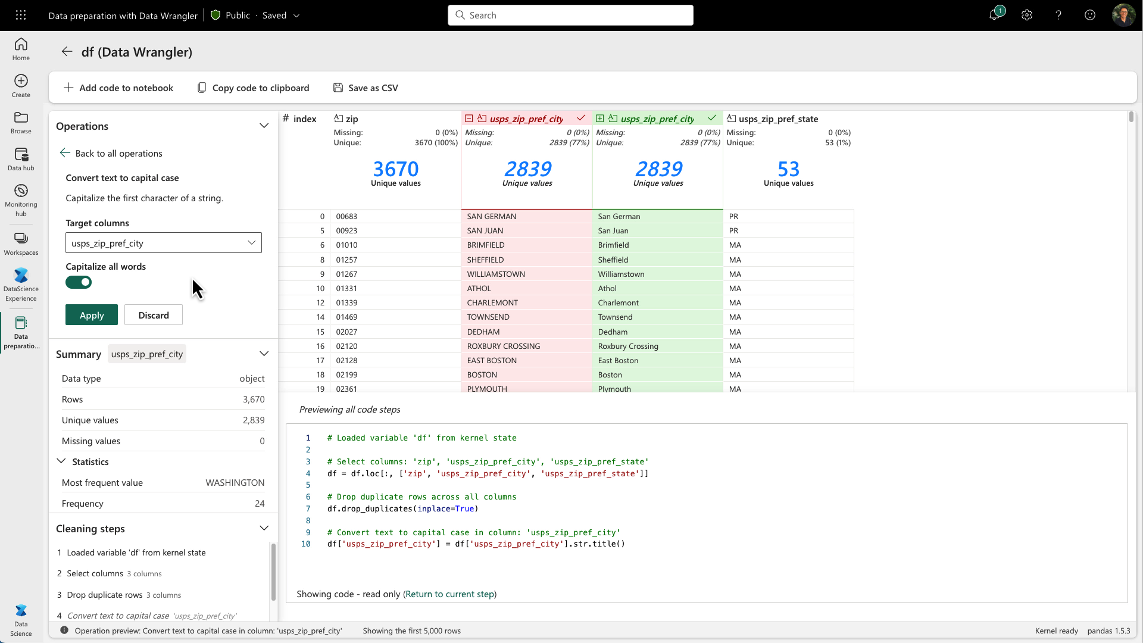
Data Science
Data Wrangler
Data Wrangler is a new data preparation tool that makes common data tasks easy. Data scientists can quickly explore the characteristics of data through built-in stats and charts, and then go ahead and clean data, extract features and do all sort of common data preparation tasks with the ease of a nice user interface. This tool generates Pandas code and in a future release it will generate Spark code too. Data Wrangler is also available today as a Visual Studio Code extension.
Let’s take a quick look at how Data Wrangler works.
Notes:
The Synapse data engineering experience in Microsoft Fabric enables you to implement data transformations the ways you want, with the tools you prefer. For a code-based ETL, you can use Spark Notebooks written in Python, Java or R, or simply execute Spark jobs with your own code. And for the most common scenarios, you can create low-code ui-based pipelines with Data pipelines and Data flows Gen 2.

Slide 28
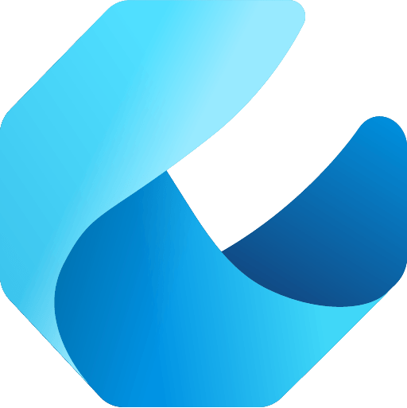





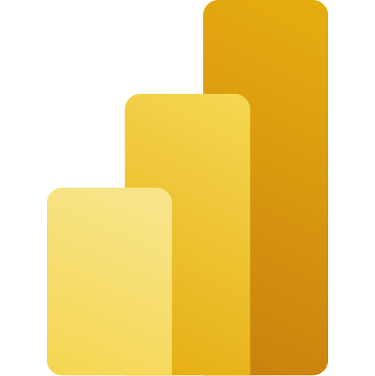


PROJECT 2 – END TO END
ARIMA Model
Time Series forecasting
Facebook Prophet Model
SQL Endpoint

Slide 29
ARIMA Model
Time Series forecasting
Facebook Prophet Model
SQL Endpoint

Slide 30
Data activator
takes action based on what's happening in your data.
Consider the following three scenarios:
A warehouse manager needs to detect drops in product stocks and needs to start a reorder process to prevent running out of stock.
A sales associate needs to receive alerts when a potential client is visiting their website and offers to start a live chat with them.
A network administrator detects potential security breaches through real-time monitoring and initiates immediate protective actions

Slide 31
Data activator
takes action based on what's happening in your data.
THINK Of...
IF function in excel or Power BI
Power Automate
SWITCH TRUE function

Slide 32
Data activator - Concepts
Events – Entire Dataset
Objects – A column of your dataset
Triggers – Conditions set to monitor your events and initiate action

Slide 33
Licensing and adoption

Slide 34
THANK YOU
Francis Folaranmi
folaranmifrancis@gmail.com

